Slide 1


Slide 2

Evaluating health outcomes: the experience of a national evaluation programme
Luigi Pinnarelli
Rome, 15-16/10/2012

Slide 3
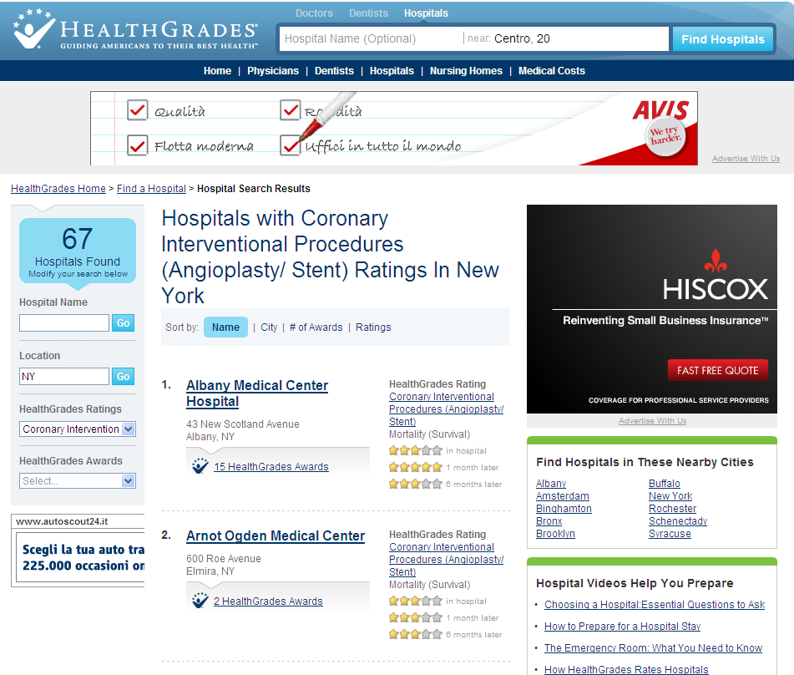
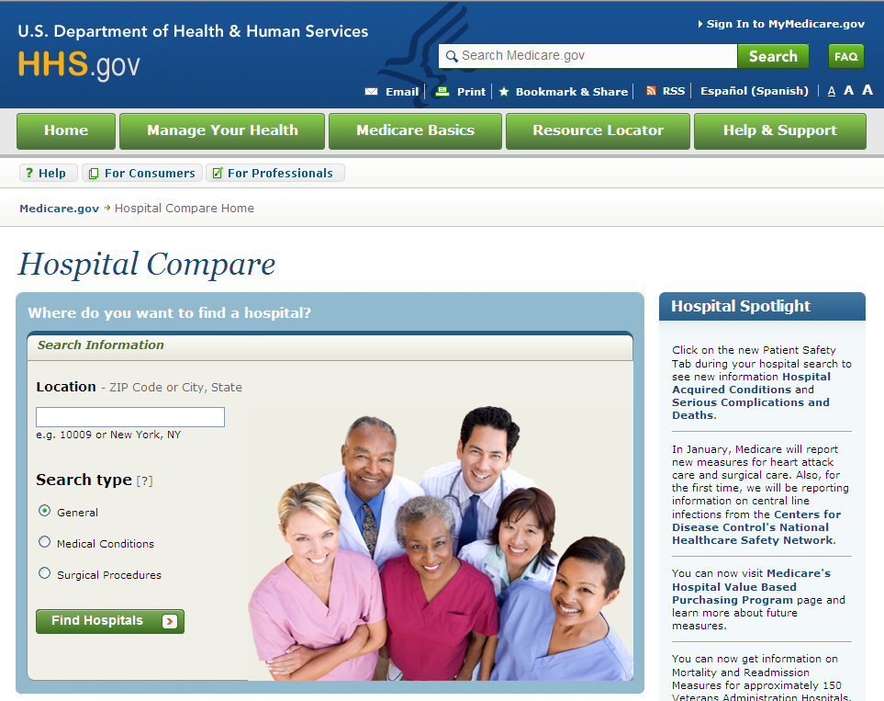
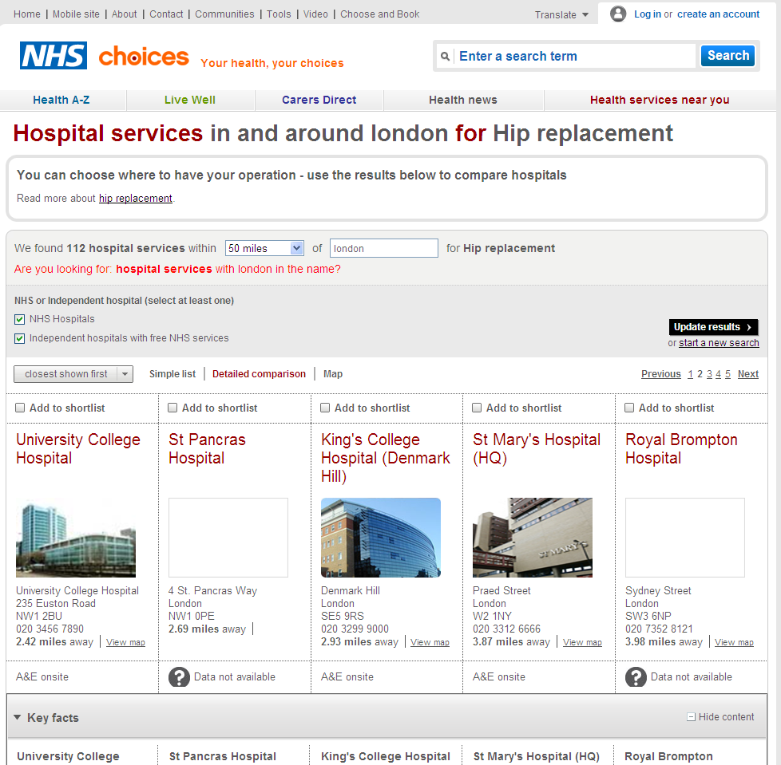
International evaluation programs

Slide 4
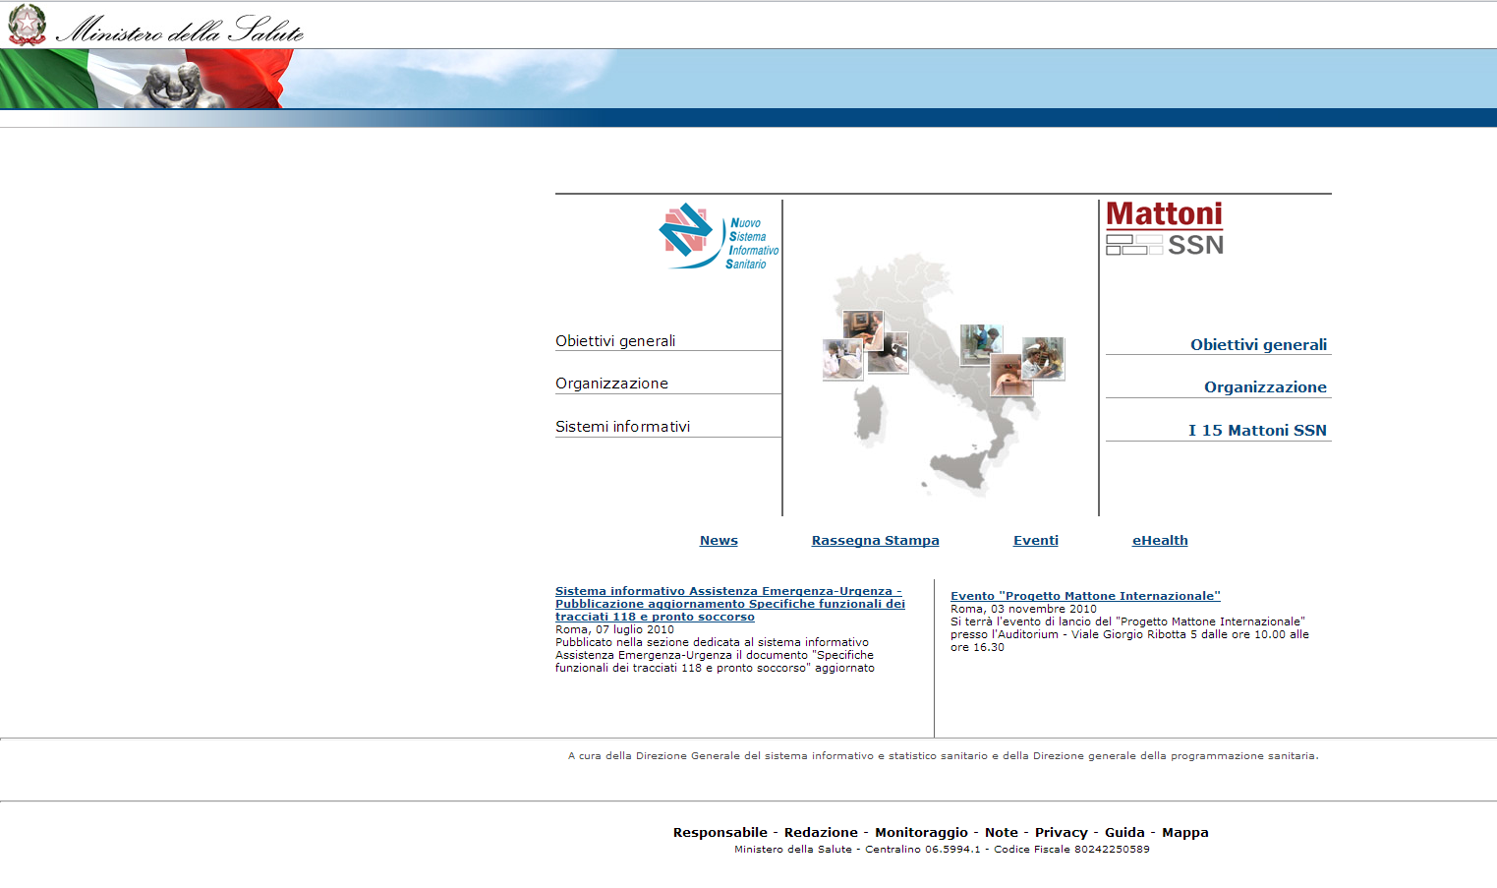
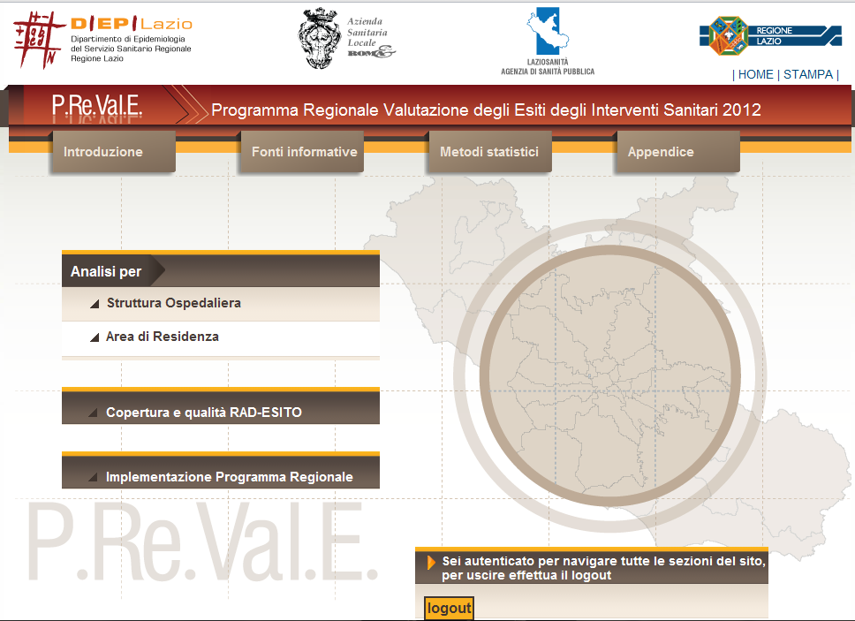
Outcome research programs in Italy

Slide 5
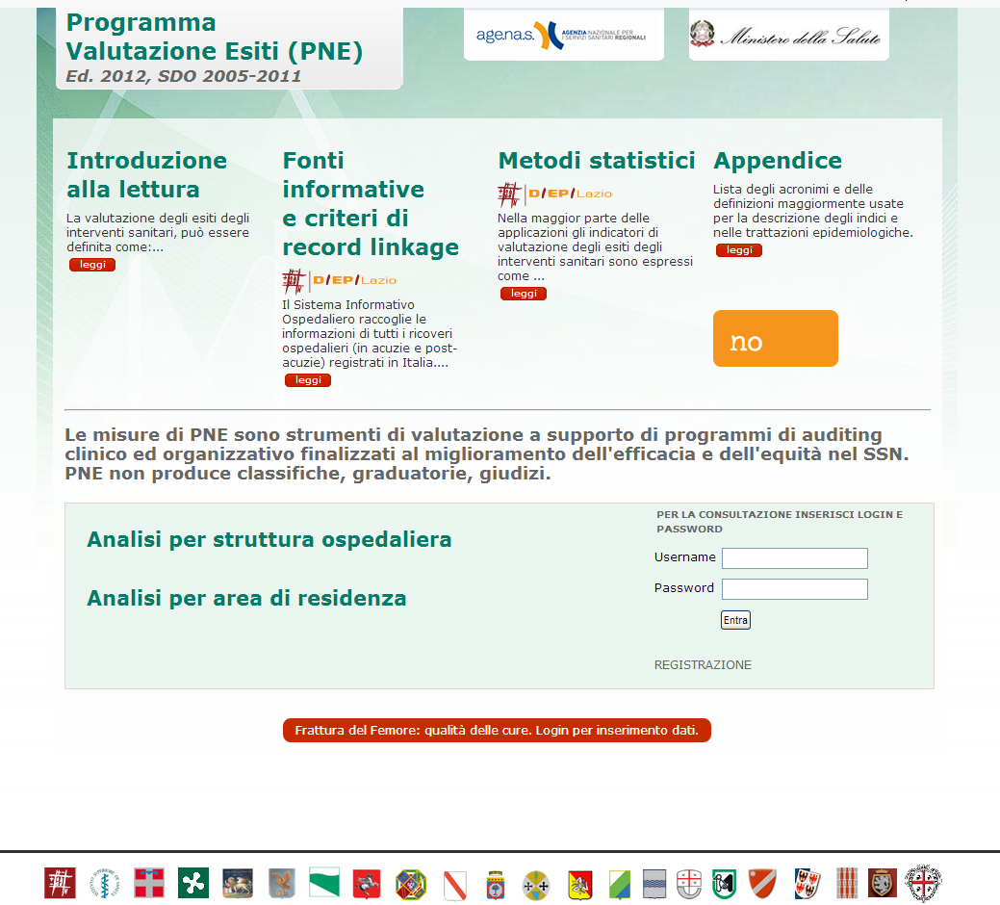
National Evaluation Program

Slide 6
Methods
Eighty-eight indicators
  Outcome indicators
  Process indicators
  Volume indicators
Clinical areas:
  Cardiology
  Obstetrics
  Pneumology
  Neurology
  Surgery
Sources of data:
- Health Information System (HIS)
- Tax record.
Statistical methodology:
- record linkage procedures
- risk adjustment techniques.

Slide 7
Results
Large heterogeneity among Italian regions and among hospitals.
  Mortality
  Length of stay
  Complications
  Hospital readmissions

Slide 8
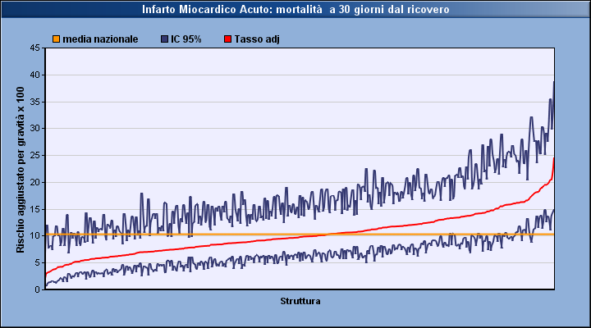
Acute Myocardial Infarction: 30 days mortality
Italy 2011
National mean
95% CI
Adj Rate
Adjusted Rate x 100
Hospitals

Slide 9
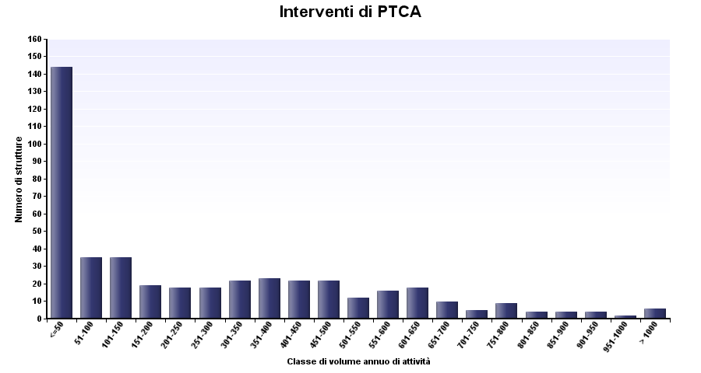
Volumes of PCI Interventions
Italy 2011
Hospitals
Volume Class

Slide 10
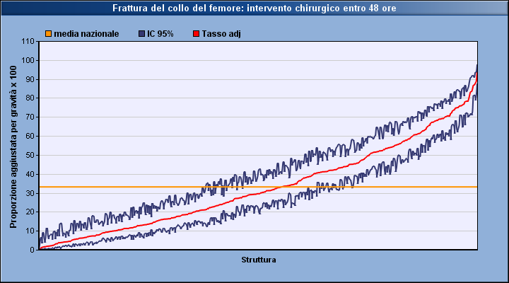
Hip fracture: surgery within 48 hours
Italy 2011
National mean
95% CI
Adj Rate
Adjusted Rate x 100
Hospitals

Slide 11
Disclosure of results
Dedicated website with restricted access
  Regional government
  Local Health Authorities
  Hospital managers
  News agencies.
Meetings with:
  General Managers
  Clinicians

Slide 12
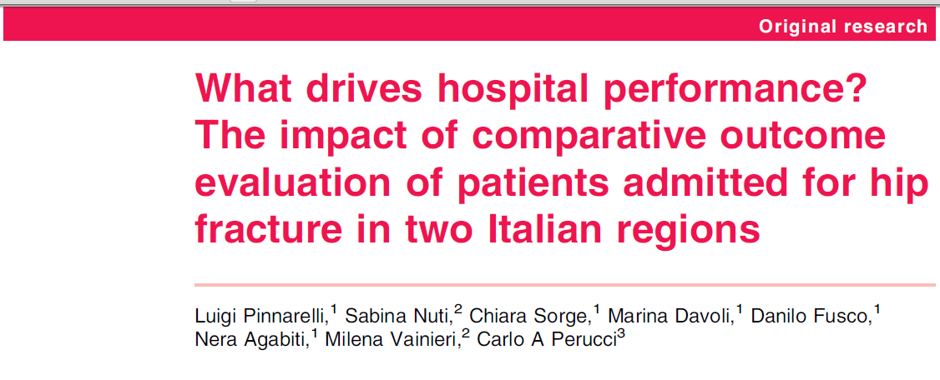
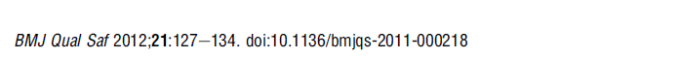
Key Points
Clinical audit
Reviewing of clinical pathways
Positive impact on quality of healthcare in some Italian regions
Region | 2006 - 2007 |  | 2008 - 2009
 | N | % | N | % | RR | p | RD
Lazio | 12585 | 11.8 | 12469 | 16.7 | 1.42 | <0.001 | 4.9
Tuscany | 11486 | 30.2 | 11122 | 45.2 | 1.49 | <0.001 | 15.0
Other Italian regions | 113436 | 29.5 | 112222 | 28.6 | 0.97 | <0.001 | -0.9

Slide 13
Key Points
Critical issues for managers and clinicians:
  “My case mix is complex! You cannot compare me with other providers!”
  “I treated N patients! Why did you evaluate only N-x patients?”
  “I do not think that P FACTOR is reliable method of evaluation!”

Slide 14

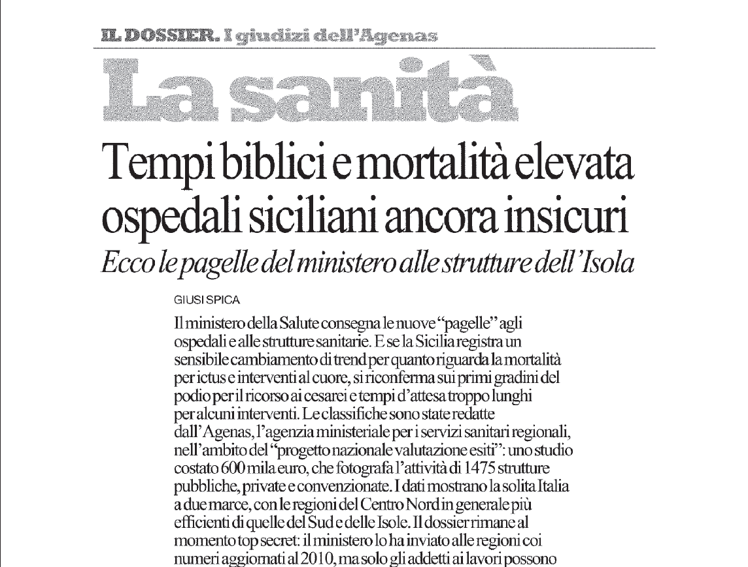
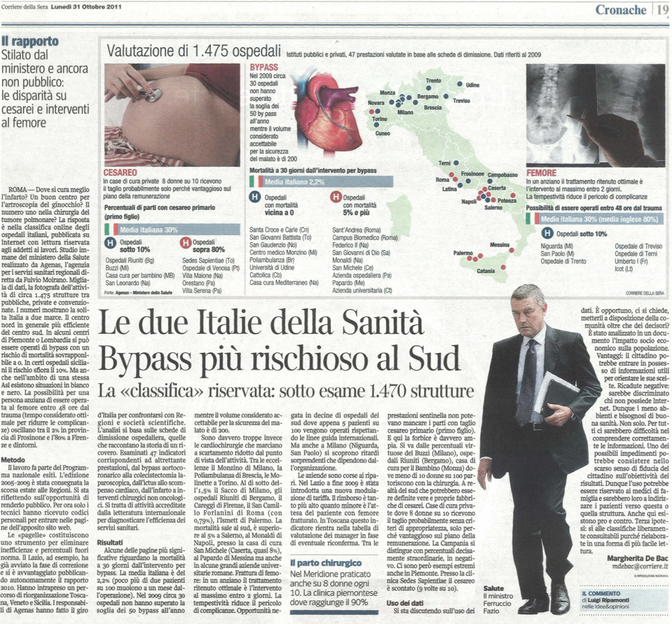
The Press
Long waiting time and high mortality:
The Sicilian Hospitals are not safe.
These are the report card of the Sicilian Hospitals
By-pass is not safe in South Italy

Slide 15
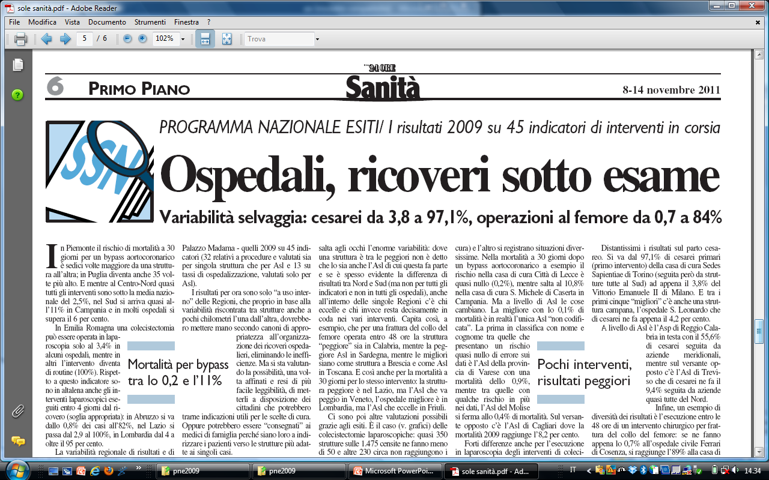

The Press
Hospitals, admissions under review
BAD & GOOD:
First report card of the Italian Hospitals

Slide 16

The Press
THE BEST ITALIAN HOSPITALS
AND WHICH ONES SHOULD BE CLOSED!

Slide 17
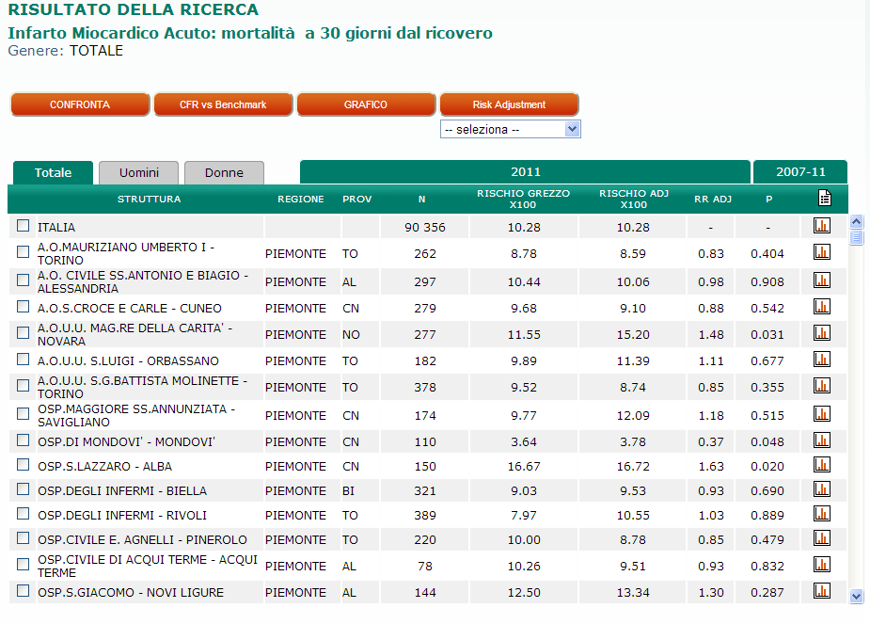
Future challenges
Distance education courses:
  asynchronous learning
  sharing the methodology
  knowledge for the correct interpretation of the results.
ADJUSTED RISK IS CALCULATED….

Slide 18
Future challenges
Audit and review of clinical pathways at national level.
HIP FRACTURE:
SURVEY FOR THE EVALUATION OF QUALITY OF HEALTHCARE

Slide 19
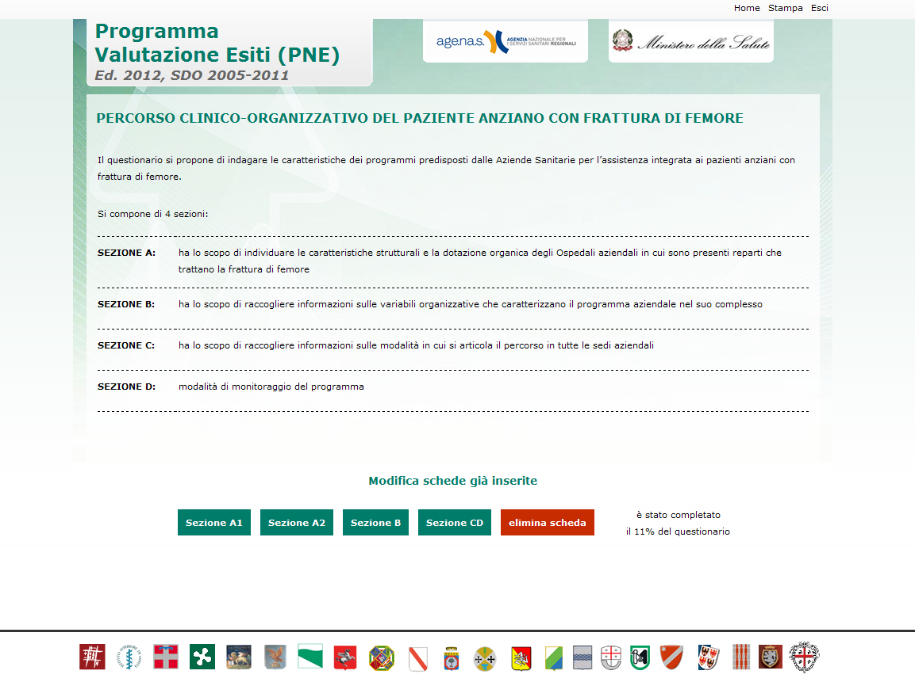
Future challenges

Slide 20
Future challenges
Choice of communications media:
  WEB
  Legacy media (TV, radio, newspaper)
  Scientific journals
Decision about the results that will be disclosed:
  Full disclosure
  Specific results
Target of the communication process:
  Regional government
  Local Health Authorities
  Hospital managers
  News agencies
  Patients

Slide 21
Future challenges
Next steps:
  involvement of managers and clinicians;
  proper collection, management and use of health data.

